Slide 1
Robust Q&A system
Akshay Satish, Kang He, Yu-ting Chen

Slide 2
Introduction
Methods
Experiments
Discussions

Slide 3
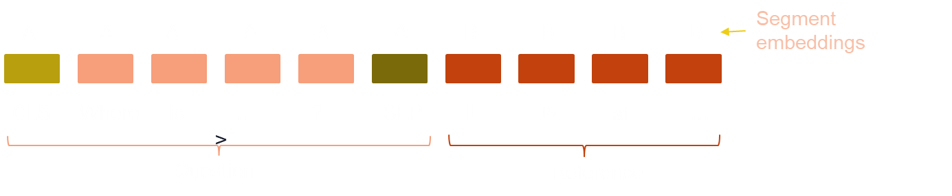
Introduction
BERT (Bidirectional Encoder Representations from Transformers) is a state-of-the-art language model in natural language processing tasks.
One of the tasks where BERT has shown remarkable performance is in Question Answering (QA), where it can accurately answer questions given a specific context.
In QA tasks, BERT is pre-trained on a large corpus of text data and fine-tuned on answering questions on a given passage.
BERT-based QA models have been used in a variety of scenarios, including chatbots, customer support.

Slide 4
Introduction
There are some challenges in solving QA task
QA system suffers from overfitting problem when training data is limited
Model fine-tuned in one domain can’t maintain the performance when handling out of domain data
The main purpose of the project is to provide possible solutions to these two challenges.
Val loss
Financial QA
Legal QA
Medical QA
Train epoch
Overfitting
Out of domain data

Slide 5
Methods
Our models are based on pre-trained BERT model
We extract and pre-process (tokenize, truncate, pad) the context paragraph, question, and answers
We train original BERT model on SQuAD as baseline for in-domain dataset
We leverage freezing BERT embedding and removing BERT encoders to alleviate overfitting issue
Two data augmentation techniques are utilized to increase the model robustness and generalizability: Data Masking and Paraphrasing
We perform inference on two out of domain dataset: Duorc and Race
We apply Distill BERT and Mixture of Experts to enhance the model performance

Slide 6
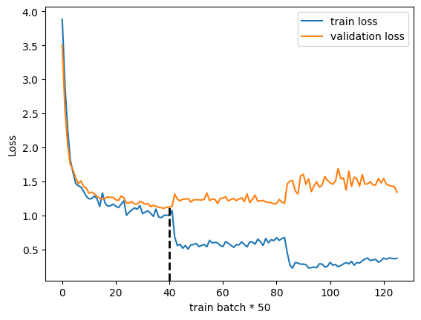
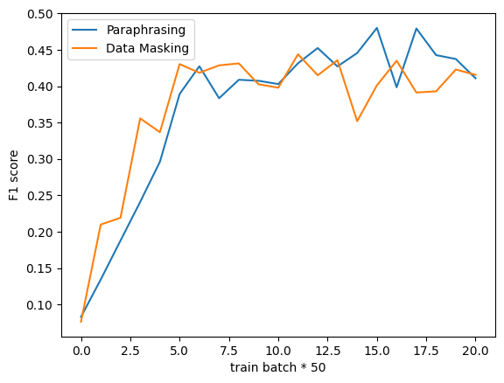
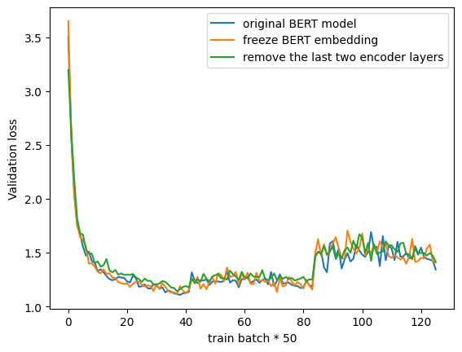
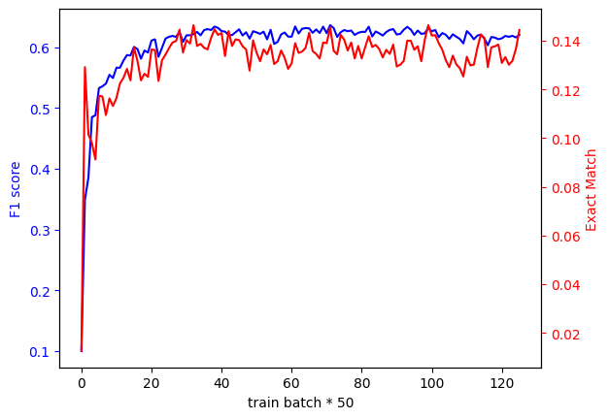
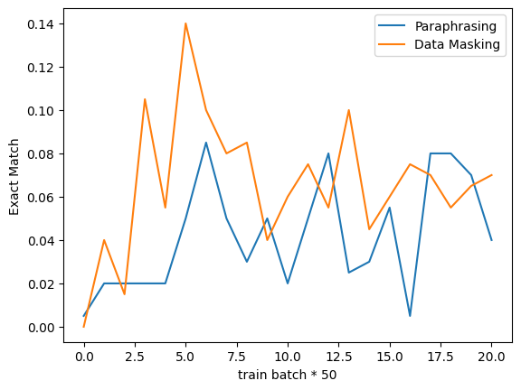
Experiments
Control trainable parameters
Freeze BERT embedding delivers the best results
Training process
(original BERT)
F1 and EM of two data augmentation

Slide 7
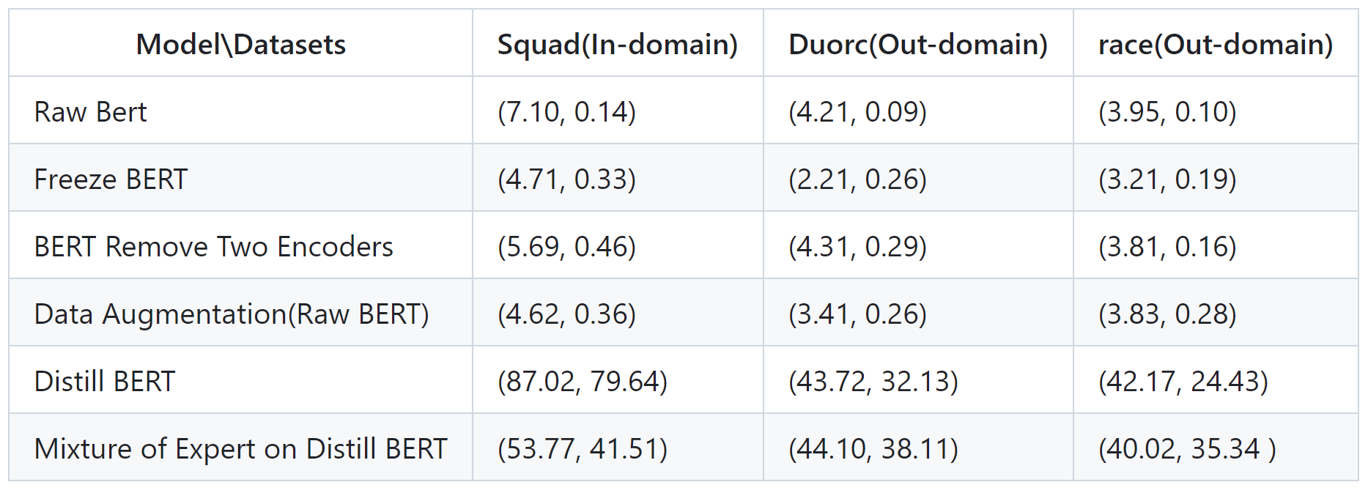
Experiments
We use F1 and EM (Exact Match) to evaluate model performance
Extensive experiment has been done on variant BERT models and under different data augmentation techniques

Slide 8
Discussion
Fine-tuning a pre-trained BERT model on a specific QA dataset can achieve good performance, but the system can suffer from overfitting problem
Out of domain dataset can be a challenge to QA system
We find freeze BERT embedding can effectively alleviate overfitting issue
We implement data augmentation techniques, but due to the limitation of training data, the performance is not improved
We utilize Distill BERT and Mixture of Experts to boost the model robustness and enhance the QA system performance

